Slide 1
Idea de SVM

Slide 2
¿Cómo separamos estos puntos?
x2
x1

Slide 3
¿Cómo separamos estos puntos?
x2
x1
Notes:
Way number 1
Precise that this separating line here is a hyperplane (a straight line in two dimensions, a plan surface in three dimensions) and that it's called "the decision boundary" in classification.

Slide 4
¿Cómo separamos estos puntos?
x2
x1
Notes:
Way number 2

Slide 5
SVM
x2
x1
Notes:
And the SVM way !

Slide 6
SVM
x2
x1
Notes:
And the SVM way !

Slide 7
SVM
x2
x1
Notes:
And the SVM way !

Slide 8
Margen máximo
Margen máximo
x2
x1
Notes:
Say that all the essence of SVM is to maximize this margin here, that is to find the Margen máximo.

Slide 9
Vectores de Soporte
Margen máximo
x2
Vectores de Soporte
x1
Notes:
Maybe should you precise that the vectors here are the vectors starting from the origin to the point itself (just to remind what a vector is). Otherwise say that the Vectores de Soporte are the data points, from each category, that are closest to the Decision Boundary.

Slide 10
Vectores de Soporte
Margen máximo
x2
Vectores de Soporte
x1
Notes:
Maybe should you precise that the vectors here are the vectors starting from the origin to the point itself (just to remind what a vector is). Otherwise say that the Vectores de Soporte are the data points, from each category, that are closest to the Decision Boundary.

Slide 11
Vectores de Soporte
Margen máximo
x2
Vectores de Soporte
x1
Notes:
Maybe should you precise that the vectors here are the vectors starting from the origin to the point itself (just to remind what a vector is). Otherwise say that the Vectores de Soporte are the data points, from each category, that are closest to the Decision Boundary.

Slide 12
Hiperplanos
Margen máximo
x2
Hiperplano de margen máximo
(Clasificador de margen máximo)
Vectores de Soporte
x1

Slide 13
Hiperplanos
Margen máximo
x2
Hiperplano Positivo
Hiperplano de margen máximo
(Clasificador de margen máximo)
Vectores de Soporte
x1

Slide 14
Hiperplanos
Margen máximo
x2
Hiperplano Positivo
Hiperplano de margen máximo
(Clasificador de margen máximo)
Vectores de Soporte
Hiperplano Negativo
x1

Slide 15
¿Qué tienen de especial
las SVM?

Slide 16
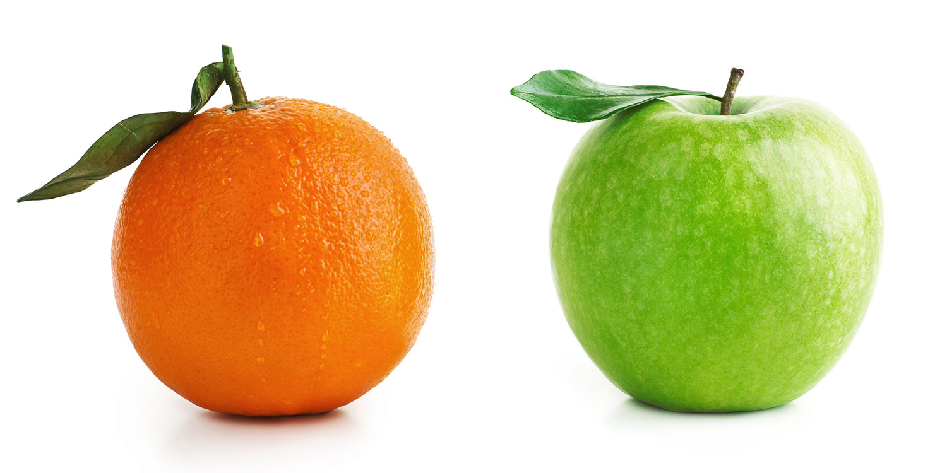
¿Qué tienen de especial las SVM?

Slide 17
¿Qué tienen de especial las SVM?
x2
x1

Slide 18
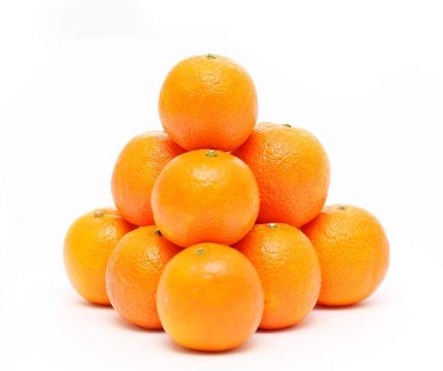
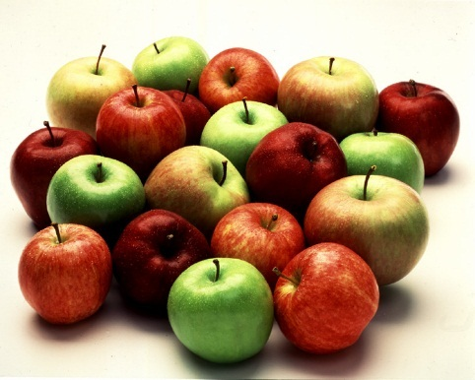
¿Qué tienen de especial las SVM?
x2
x1

Slide 19
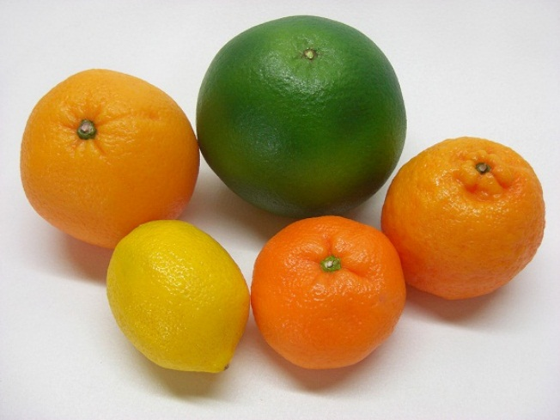
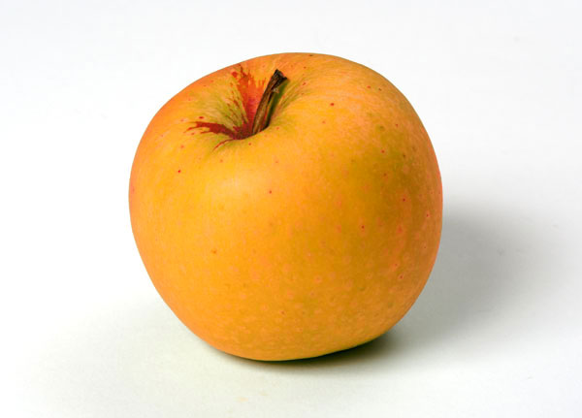
¿Qué tienen de especial las SVM?
x2
Vectores de Soporte
x1
Notes:
Think for this another time. If you would want your kid to learn to differentiate between an apple and orange you would show him a perfect apple and a perfect orange. But not SVMs they want to only see an apple that looks like an orange and vice versa. This approach is very different from how most Machine learning algorithms operate, and maybe thats why it works so well in some cases.

